Slide 1
SRSD Day2 worksheet
Instruction: This activity involves a group discussion. Each participant is required to submit their work individually, although it's permissible to submit the same file as their teammate.

Slide 2
Team members
List your team members’ full name (as in your course registration)

Slide 3
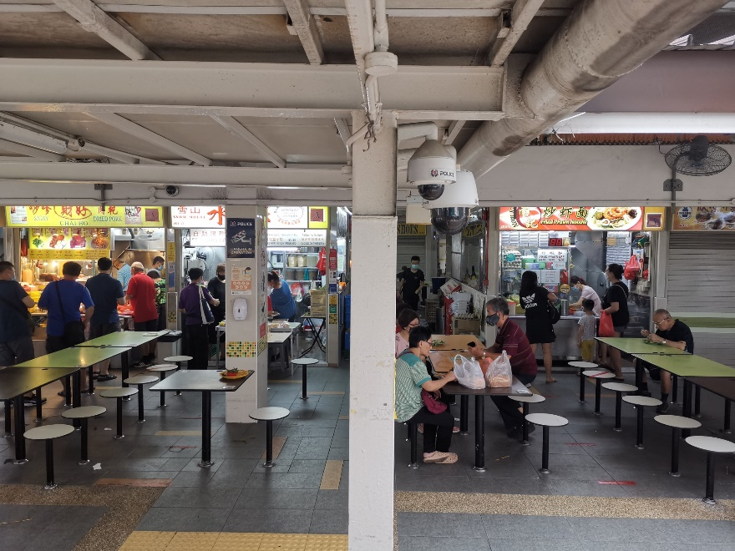
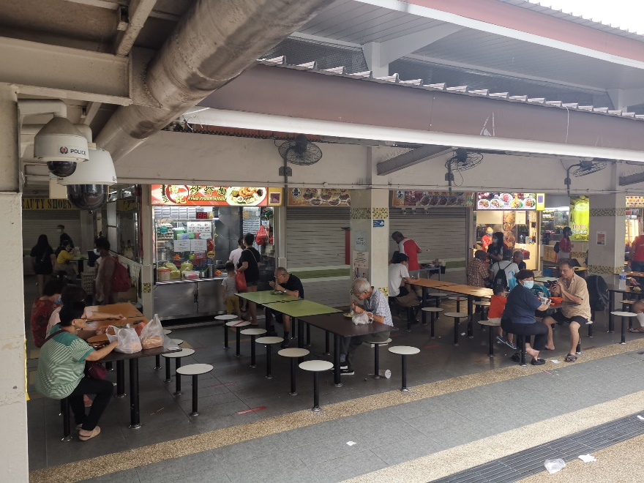
Question
You are engaged by an AI company to develop an intelligent sensing system to manage and enhance our hawker centers, where people can enjoy their food in a clean and hygienic environment. To provide an ‘overlapping index’, which is defined as the number of pixels in the overlapping area divided by the total number of pixels. This can optimize the CCTV camera infrastructure so that it has sufficient overlapping coverage for the monitored public area. In your answers, you need to describe the technical flow chart of your proposed solution.
Camera 1
Camera 2
Overlapping region between Camera 1 and Camera 2.

Slide 4
Your answers

